Slide 1

Solution in parts per millions ;)

Slide 2
What Is Cora?
Is a smart solution for the industrial air pollution monitoring system.
An affordable and simple project that integrates IoT and blockchain technologies.
A smart web that is connected with companies , people and government.

Slide 3
Why cora ?
The air pollution caused by the industries are becoming a major issue in our country.
Improper monitoring, alerting and Reviewing the pollution emissions are the major problem facing in our area.
The aggressive urbanization and industrialization have elevated the pollution level even further.
most of the developing countries like India end up with sparsely distributed devices leading to lack of visibility, granularity and substantial monitoring of air quality.

Slide 4
Due to the sparsely distributed devices across the country, the government is facing challenges to understanding the changes in their micro-environments due to lack of data.
Lack of proper information is leading to improper policy frameworks, city planning and at times, end up with improper decision making, which ultimately results in the public disinterest.

Slide 5
Technologies used :
The Internet of Things (IoT) is a system of interrelated computing devices, mechanical and digital machines, objects, animals or people that are provided with unique identifiers and the ability to transfer data over a network without requiring human-to-human or human-to-computer interaction.
Blockchain Technology
A blockchain is a digitalized, decentralized, public ledger of any type of transactions. Constantly growing as ‘completed’ blocks (the most recent transactions) are recorded and added to it in chronological order, it allows market participants to keep track of transactions without central recordkeeping. Each node (a computer connected to the network) gets a copy of the blockchain, which is downloaded automatically.

Slide 6
Blockchain a brief description
Each “block” represents a number of transactional records, and the “chain” component links them all together with a hash function. As records are created, they are confirmed by a distributed network of computers and paired up with the previous entry in the chain, thereby creating a chain of blocks, or a blockchain.
The entire blockchain is retained on this large network of computers, meaning that no one person has control over its history. That’s an important component, because it certifies everything that has happened in the chain prior, and it means that no one person can go back and change things.
It makes the blockchain a public ledger that cannot be easily tampered with, giving it a built-in layer of protection that isn’t possible with a standard, centralized database of information.
Smart contracts help you exchange money, property, shares, or anything of value in a transparent, conflict-free way while avoiding the services of a middleman.

Slide 7
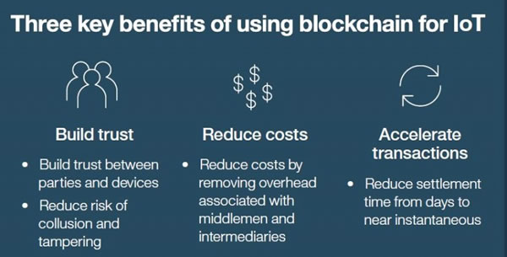
IoT and Blockchain

Slide 8
PROJECT C.O.R.A
The proposed solution is that to monitor major polluting industries and their emission using sensors like MQ-135 and store the data into the block chain system.
The data feeds are updated using the wifi module into suitable blocks and if the emission limits are exceeded, reports will be send to pollution control boards of state and central levels and to the news Media.

Slide 9
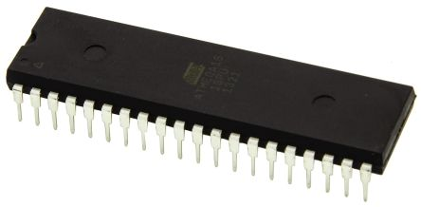

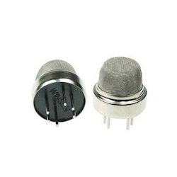
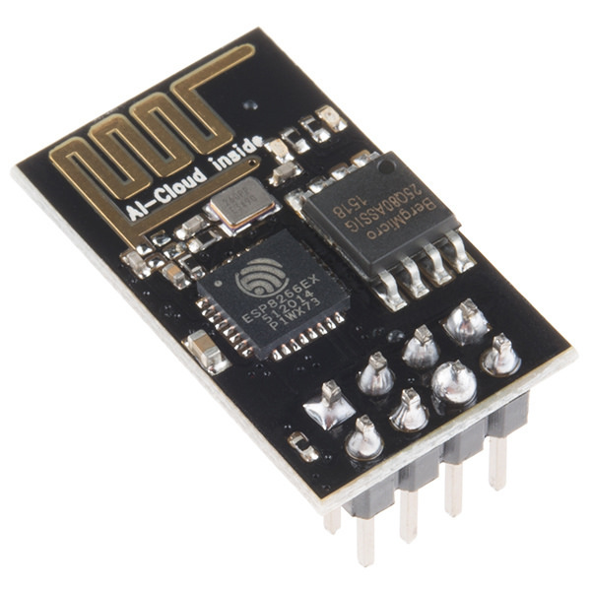

Hardware and softwares
1.Prototyping board - atmega 16
3.MQ -135 sensor
4.ESP8266 Wi-Fi module
5.connecting wires.
6.power supply.
7.Atmel studio
8.avr burner gui
9.thingspeak and Hyperledger fabric web platform

Slide 10
BRIEF DESCRIPTION
As described earlier ,air pollution is becoming a major and hazardous environmental disaster. Steps for active monitoring of the emissions are not helping much as of now.
So here comes the role of our idea where every polluting industries and companies are constantly monitored in terms of their emission which is stored in a way that the data cannot be tampered or manipulated.
With an atmega board , MQ-135 gas sensor to detect combustible gas , wifi module and some other basic components can make this a reality. The data collected by the gas sensor can be stored as blocks by using blockchain technology.
The smart contracts coded into the blockchains can monitor the values and if exceeds the safe limit can trigger notifications for the concerned authorities , respective companies and news media so that everyone could be aware of the situation and to take proper action.

Slide 11
Future of C.O.R.A
An interconnected number of mq135 sensors for each industry
Cloud storage facility for easy access
Using more powerful microcontroller.

Slide 12
Thank You ;)
1st Year Students of Viswajyothi College of Engineering and Technology,Vazhakulam

